Slide 1
Natural Language Processing
Week 6

Slide 2
Good evening, everyone. Welcome to the live session.
Today, we will be practicing problems from the current week’s content.
We will wait 5 minutes for everyone to join in and start at 7:05 pm.

Slide 3
Question 1: Which of the following is/are true about the Chu-Liu-Edmonds Algorithm?
1. Each vertex in the graph greedily selects the incoming edge with the highest weight
2. During the iteration of algorithm it always produce minimum spanning tree
3. During the iteration of algorithm it never produces cycle
4. The running time of the Algorithm is O(EV) where V be the set of nodes and E be the set of directed edges

Slide 4
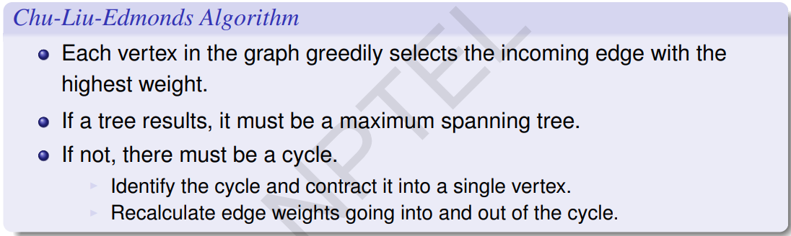
Solution
Answer: 1, 4
Solution: During the iteration of the algorithm it always produces a Maximum spanning tree and it might produce cycle also.

Slide 5
Question 2. With respect to a Dependency Structure, which of the following is not a valid criterion for a syntactic relation between a head H and a dependent D in a construction C?
1. The form of D depends on H. - right
2. The form of H depends on D.
3. H selects D and determines whether D is obligatory. -right
4. H specifies D.

Slide 6
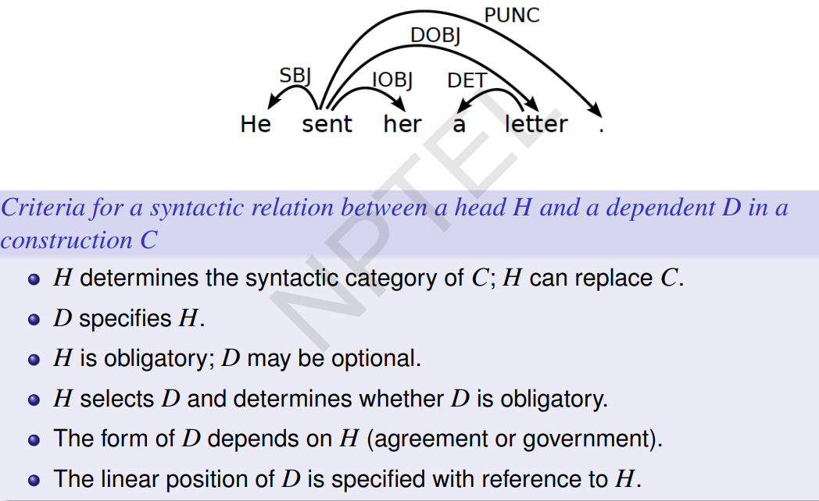

Slide 7
Solution
Answer: 2, 4

Slide 8
Question 3: Consider the sentence: “Ramesh scored a brilliant century”. What is the type of the following relation?
century -> brilliant
1. Endocentric
2. Exocentric
3. Both endocentric and exocentric
4. None of the above

Slide 9
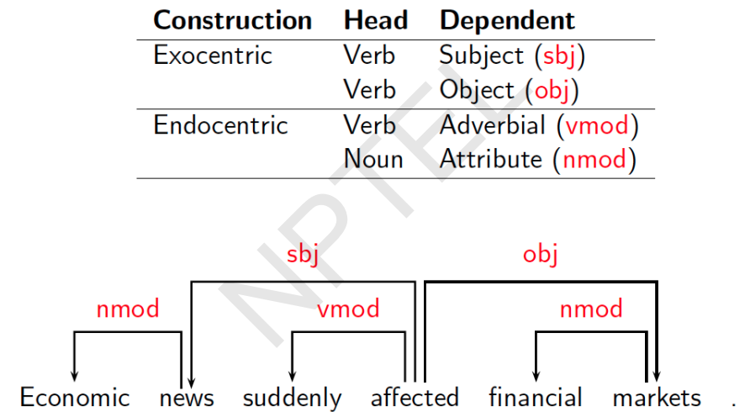

Slide 10
Solution
Answer: 1

Slide 11
Question 4: Which of the following is /are false about data driven deterministic parsing?
1. Deterministic parsing requires an oracle
2. An oracle can be approximated by a classifier
3. A classifier can be trained using treebank data
4. None of the above

Slide 12
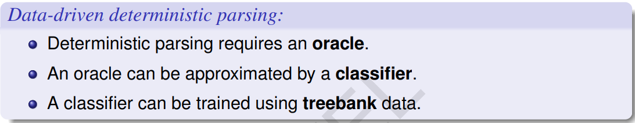
Solution
Answer: 4
Solution:
For data driven deterministic parsing 1,2,3 all are true.

Slide 13
Question 5: Suppose you write down the sequence of actions that generate the parse tree of the sentence “I prefer ChatGPT course" using Arc-Eager Parsing. Assume the sentence is a gold-standard parse in your training data.The number of times you have to use Right Arc, Left Arc, Reduce, Shift is:
Format of the answer is [a, b, c, d] corresponding to the 4 values in the order specified in the query.
1. [3, 0, 2, 1]
2. [1, 2, 1, 3]
3. [1, 2, 0, 3]
4. [1, 2, 0, 2]

Slide 14
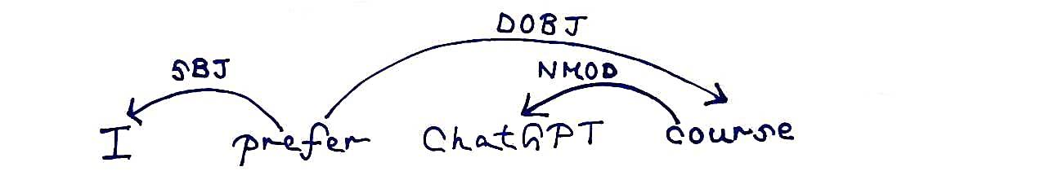
Solution
Answer: 3

Slide 15
Question 6: Correct sequence of actions that generates the parse tree of the sentence “I prefer ChatGPT course” using Arc-Eager Parsing is:
Note: Right Arc (RA), Left Arc(LA), Reduce(RE), Shift(SH)
1. SH->LA->SH->SH->LA->RA
2. SH->LA->SH->RE->LA->RA
3. SH->LA->SH->SH->RA->LA
4. SH->LA->RE-->SH->SH->LA

Slide 16
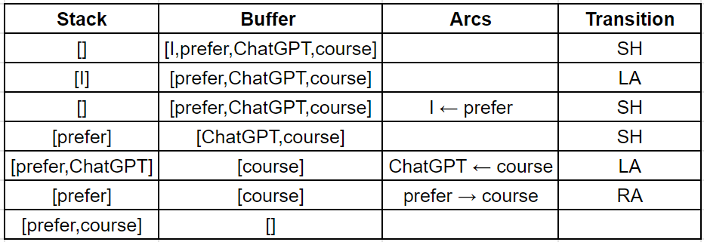
Solution
Answer: 1

Slide 17
Question 7: Suppose you are training MST Parser for dependency and the sentence, “I like online exam” occurs in the training set. The POS tags for these words are Pronoun, Verb, PropNoun and Noun, respectively. Also, for simplicity, assume that there is only one dependency relation, “rel”. Thus, for every arc from word wi to wj, your features may be simplified to depend only on words wi and wj and not on the relation label. Below is the set of features
f1: pos(wi) = Verb and pos(wj) = Noun|Pronoun
f2: wi = Root | wi occurs before wj in the sentence
f3: wi = Root and pos(wj) = Verb
f4: wj occurs before wi in the sentence

Slide 18
Question 7: The feature weights before the start of the iteration are: [5,20,15,12]
Suppose you are also given that after applying the Chu-Liu Edmonds, you get the following parse tree {Root → like, like → I, I → online, online → exam}
What would be the weights after this iteration?
1. [6, 19, 14, 13]
2. [6, 19, 15, 13]
3. [6, 19, 13, 13]
4. [6, 19, 15, 12]

Slide 19
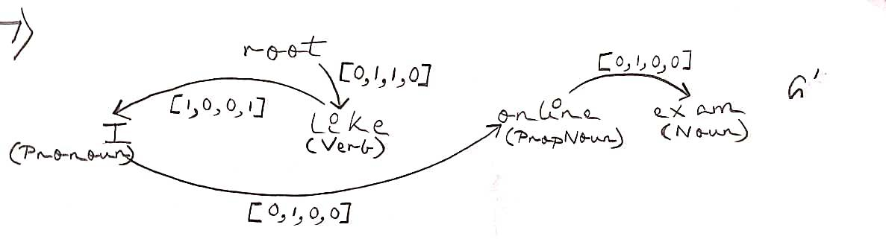
Solution
Answer: 2

Slide 20
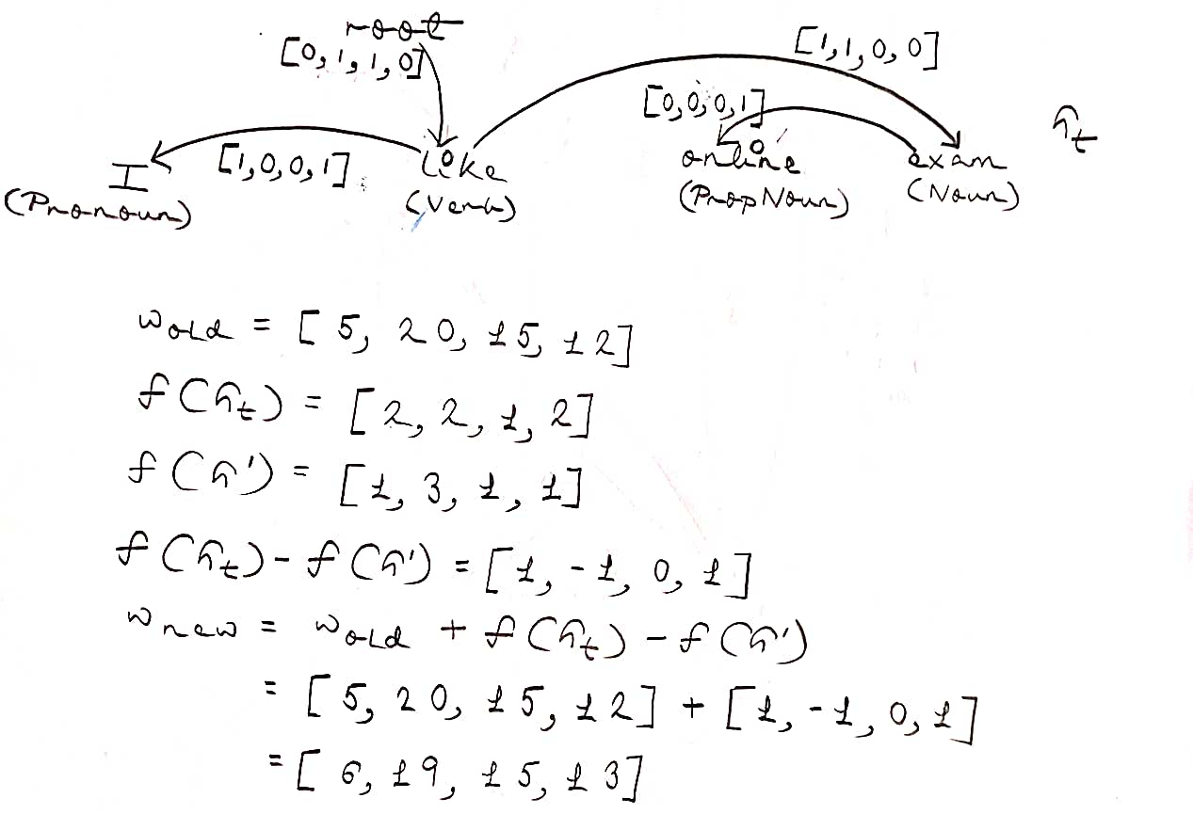

Slide 21
Question 8: Which of the following is true about the formal conditions on dependency graph ?
1. Graph G is connected and projective
2. G is connected but not acyclic
3. G acyclic and obeys the single head constant
4. Both 1 and 3

Slide 22
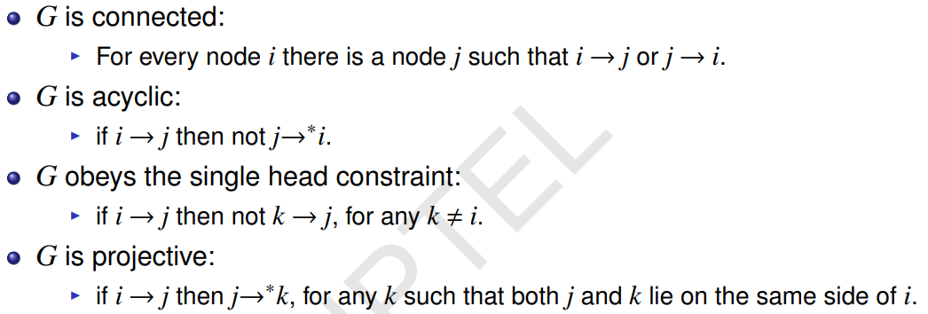
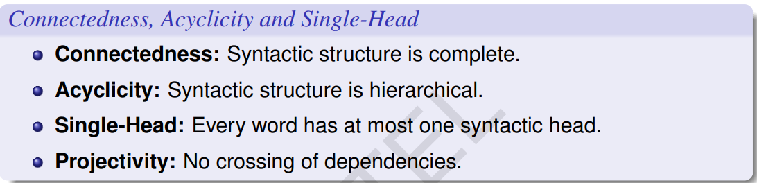

Slide 23
Solution
Answer: 4
Solution:
The formal conditions on dependency graphs are that G is connected, acyclic, projective and should obey single head constraint.

Slide 24
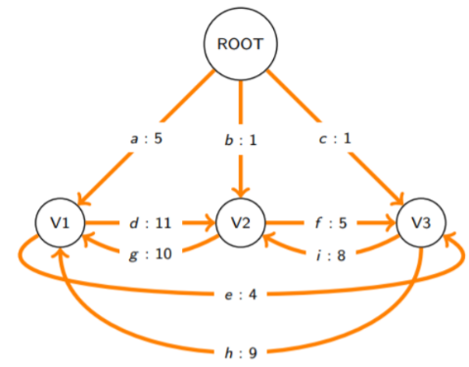
Question 9: Consider the following graph with a root node and 3 other vertices. The edge weights between all the pair of modes have been provided. Suppose you use Chu-Liu-Edmonds algorithm to find the MST for this graph. Which pair of nodes will have to be contracted to form a single vertex during the algorithm in the 1st iteration?
1. (V2, V3)
2. (V1, V3)
3. All these pairs will get contracted at different times in the algorithm
4. (V1, V2)

Slide 25
Solution
Answer: 4
Solution:

Slide 26
